Slide 1


Metrological Traceability in Practice
September 2025
Nele Van den Eede
Apr. klin. biol.
Pierre BASTIN
Ph. Biologiste

Slide 2
Plan
Metrological Traceability ?
Regulatory standard
Voluntary standard ➔ Steps summarized in practice
Directive 2025: what’s new ? + comparison (ISO15189:2022, BELAC 2-003 R4-2022)
Notes:
We zullen eerst de definitie bekijken, de regelgevende standaarden, gevolgd door de standaarden om een accreditatie te behalen. Ten slotte bekijken we de nieuwigheden in de praktijkrichtlijn van 2025 en vergelijken we deze met de ISO15189 norm van 2022 en de overgangsprocedure van BELAC 2-003 2022

Slide 3
Context
Importance of traceability for reliable and consistent analytical results
A still‑complex subject
Update and harmonisation of quality requirements, patient-based (2025 directives, ISO 2022)
The three application standards in Belgium
🔸 Legal standard → Royal Decree of December 3, 1999
🔹 Regulatory standard → Practical Guidelines (v2025)
🔸 Voluntary standard → ISO 15189 standard + BELAC 2-003 for traceability requirements (+ ILAC)
Notes:
Avec les dernières mises à jour des référentiels, on observe une tendance à l’harmonisation entre les exigences facultatives présentées dans la nouvelle version des directives pratiques et celles de notre norme ISO 15189.
Le sujet reste complexe, mais il est essentiel pour garantir des résultats analytiques fiables et cohérents.

Slide 4
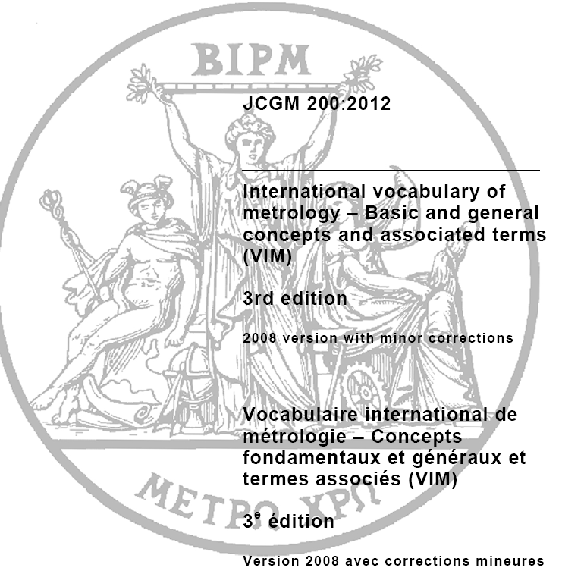
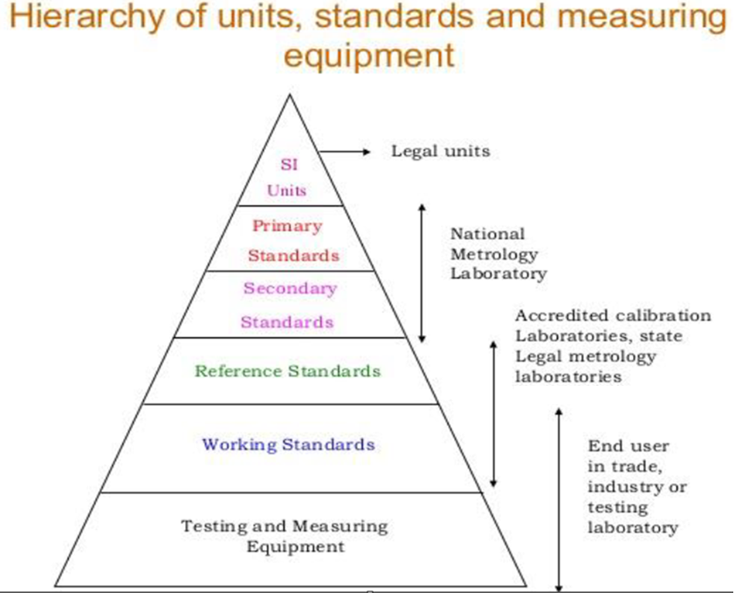
Definition
Metrological Traceability (VIM)
= Property of a measurement result whereby:
this result can be linked to a specific reference (usually an SI unit)
through an unbroken and documented chain of calibrations,
each contributing to the measurement uncertainty
Notes:
VIM = vocabulaire international de métrologie

Slide 5
Metrological traceability in key words :
for each stage of the chain:
uncertainty of measurement;
Documentation (whose assessment criteria/evidence)
competence;
reference to SI units;
calibration intervals (Directives ILAC G24, risk-based assessment)
G24: “Guidelines for the determination of calibration intervals of measuring instruments” )
Notes:
En quelques mots clés, le concept de tracabilité métrologique inclut
Pour chaque étape entre l’étalon primaire international et l’équipement de mesure,
:
- L’incertitude de mesure : calculée pour chaque étape; permettant le calcul d’une incertitude global;
- chaque étape doit être documentées et les résultats enregistrés en insistant sur les critères et preuves d’évaluation ;
- La compétence : les organismes chargés de l’exécution doivent prouver leur compétence technique en matière de tracabilité, qu’elle soit réalisée en interne ou soustraitée ;
La chaîne des comparaisons doit permettre le lien vers les étalons primaires internationaux
Et enfin, Les étalonnages doivent être répétés à des intervalles réguliers dont la durée dépend de plusieurs facteurs comme par exemple : le niveau d’incertitude, la fréquence d’utilisation, les modes d’utilisation, la stabilité de l’équipement). Si le sujet vous passionne, les directives ILAC G24 sont pour vous !
ILAC G24

Slide 6
Metrological traceability, which goal ?
To control and document bias and measurement uncertainty
Enabling control on biological reference interval and clinical decision limit

Slide 7

Regulatory standard
AR 1999 - Article 28 §5
2. Formal requirements of the Practical Directives (V4:2025)
“6.5.1.A: The laboratory must have procedures in place for performing controls and calibrations,
And for managing and releasing measuring equipment and standards.”
---------------------------------
do not affect the reliability of the results in the current state of science.” “The reference materials used must be traceable to national or international standards. Where these conditions cannot be met, other equivalent procedures may be used provided that they
➔ The other elements presented here from the v4 practical Directives are included in “Comments.”
A “comment” is an optional requirement, best practice, example, suggestion, recommendation, or existing guideline that may help the laboratory develop its own quality system.
Notes:
L’exigence formelle reprise dans les directives pratiques de 2025 est fondée sur l’arrêté royal de 1999.
Cette obligation stipule que le laboratoire doit, je cite, « disposer de procédures pour effectuer les contrôles et les étalonnages, la gestion et la libération des équipements de mesure et des étalons.
Cette exigence présente dans la version 2017 des directives ne change pas
Les matériaux de référence utilises doivent être liés à des étalons nationaux ou internationaux. Au cas où ces conditions ne peuvent être suivies, d’autres procédures équivalentes peuvent être utilisées pour autant qu’elles n’altèrent pas la fiabilité des résultats dans l’état actuel de la science.

Slide 8
Calibration ≠ Verification
Verification
Confirmation of truthfulness, by providing objective evidence that the specified requirements have been met
➔ Concept of “control result” and acceptability threshold
Sufficient for Non-critical equipment
E.g. daily checking of the scale with a test weight
In-house
----------------------------------------------
Calibration
Procedure which, under specified conditions:
(1) first establishes a relationship between the known values of measurement standards, with their associated measurement uncertainties, and readings with their associated measurement uncertainties,
(2) and then uses this information to establish a relationship in order to obtain a measurement result for an indication.
➔ Concept of bias and uncertainty, relationship between higher-level standard, laboratory standard, and routine measurement
Needed for critical equipement
In-house or external
What is critical equipment and how can it be identified?

Slide 9
Steps summarized in practice (according to BELAC, Comments Dir. Prat.)
Risk analysis determined the degree of criticality:
  Does the measurement accuracy or measurement uncertainty of this equipment SIGNIFICANTLY affect the validity of the analysis results?
  Does this instrument contribute significantly to measurement uncertainty/accuracy?
----------------------------------------------------------------------------------------------------------------
Source :
Practice Guidelines 2025 (Comments § 6.5.1)
  "The modalities for carrying out or outsourcing these activities, as well as their frequency, must be defined."
  "The equipment [...] can be checked when the laboratory considers them to be critical on the basis of a risk analysis. »
ISO 15189:2022 (§6.5.2) :
  "Verification by frequency – reinforcement of the requirement with the notion of explicit specified frequency."
  "Risk-based actions if out-of-bounds calibration/verification.“
BELAC 2-003 Rev 4-2022: ”As for measuring equipment that has little or less impact on the uncertainty or the validity of the result: Regular “verifications” may suffice in this case.”

Slide 10
Examples of potentially critical equipment (non exhaustive, to defined by the lab)
Equipment | Why it is criticized ?
Pipettes | Dosage inexact → dilution/fausse concentration
Balances | Incorrect mass of a reagent or standard
Thermometers | Incorrect temperature → instability of some reagents
pH Meters | Out-of-specification pH → alteration of enzymatic reactions, instability
Centrifuges | Poor G-Force → inadequate separation
….
Notes:
À titre d’exemples quelques interrogations à poser afin d’aiderà identifier les équipements critiques

Slide 11
To summarize
Risk assessment ➔ criticality status (= impact on accuracy or measurement uncertainty)
  The need for calibration and/or a verification
  The specified intervals of its calibration/verification (Dir ILAC G24, 5 proposed methods)
2. If calibration, in-house or external ?
  In-house: calibration procedure, laboratory is responsible for demonstrating compliance
  External: SLA, supplier evaluation + for accreditation: accredited supplier if available
➔ if no accredited external supplier available (= National Standards Service or ISO17025:2017),
The laboratory is responsible for demonstrating compliance
Notes:
Pour la majorité des appareils de mesure — tels que les balances, les pipettes ou les thermomètres — la norme d’accréditation de référence est l’ISO 17025:2017.
((( obligations des directives:
6.8.3.A : Le laboratoire doit disposer d'une procédure de sélection et d'évaluation périodique des fournisseurs et sous-traitants critiques.
6.8.3.B : Une liste de fournisseurs critiques agréés est disponible.
)))

Slide 12
News ? Comments or small additional requirements ☺
Domain | Directives 2017 §5.3.1.4 ➔ 2025 §6.5 (Comments) | BELAC 2-003 + ISO 15189 2012 §5.3.1.4 ➔2022 §6.5
Calibration / Verification | Integration of requirements for outsourcing with ISO 17025 accreditation recommendations. Introduction of an explicit frequency of checks (in comments). | Introduction of an explicit frequency of checks (risk-based approach) Split between calibration (6.5.2) and traceability (6.5.3)
Traceability | Traceable and within the measurement range certified materials The following elements could be incorporated into the procedure: storage conditions, working method, and registration. | Traceability required via certified materials (BELAC 2-003)
Corrective actions | If necessary, to analyze impact on results that have already been validated and disseminated. The IQC results may be taken into account in this regard. | Actions to be taken if out of bounds based on risk analysis on patient and service provided
Methods | Addition of specific rules for semi-quantitative and POCT methods. | 6.5.3 d) specific traceability requirement for genetic results (genetic reference sequence) 6.5.3 e) specific traceability requirement for semi-quantitative, qualitative methods
Notes:
Globalement, il faut:
Identifier/controler les influences sur res. Final (ANALYSE RISQUES
Établir la validité des res. : CQE, réanalyse, diversifier les méthodes analytiques (int. Réaction)

Slide 13
Elements still present (Dir v4:2025 Comments, ISO15189/BELAC 2-003: 2022)
Domain | Constant elements
Metrological traceability principle | Requirement to ensure a documented chain of custody for all critical instruments and measures (Critical to be determined by the lab (impact on result/patient).
Use of reference materials | Recommendation to use reference materials traceable to national or international standards (SI units).
Calibration/verification Process | Need to have process for calibrating, managing, and releasing equipment. Calibration/verification by competent personnel Instructions must be available, understandable and accessible to staff (especially if translation is required).
Records | Equipment records + registrations of calibration status + date re-calibration + measurement uncertainty
Staff qualifications | Calibrations/verifications must be performed by qualified personnel (internal or external)
Corrective actions in case of deviations | If deviations are detected, corrective actions must be taken and documented (patient focus)

Slide 14
Content in a calibration procedure (Dir. V4:2025 Comments, ISO15189/BELAC 2-003: 2022)
Category | What to include | Detail / comment
Equipment used | Use of certified materials
 | Measuring instrument used | Must be traceable itself, with indication of its calibration status and validity date, measurement uncertainty
Methodology | Conditions and place of storage | For standards and measuring equipment used
 | Environmental conditions | E.g.: temperature, humidity, workstation stability
 | Working method | In-house or external
 | Calibration Frequency | Defined according to criticality (risk analysis)
 | Security measures | To prevent unauthorized manipulation or adjustment
Recording & Traceability | Frequency and method of recording | Results should be documented in a systematic manner
 | Acceptability criteria | E.g., maximum permissible tolerances to decide on which actions should be undertaken
 | Identifying the status of the equipment | Clear indication of the verification or calibration status (and expiry date))
 | Equipment logbook | Signed history of the interventions, with the date of the next calibration
In the event of a discrepancy | Measures to be taken if out of tolerance | Planned corrective actions and impact assessment on validated results
Other requirements | Accessibility of supplier instructions | If used, they must be understandable, in a language known to the staff and easily accessible
➔ if no accredited external supplier available (= National Standards Service or ISO17025),
The laboratory is responsible for demonstrating compliance
Notes:
Je ne ferai qu’insister sur l’importance de l’etablissement d’une frequence d’étallonage rationnellement basé, de bien définir les critères et mesures à prendre si dépassement des critères

Slide 15
Records (to keep!) during a calibration (Dir. V4:2025 Comments)
What to save | Description / Accuracy
🔹 Controlled Equipment Reference | Inventory number or unique ID of the instrument concerned
🔹 Execution date | Full date of calibration
🔹 Identity of competent person | Name or identifier of the person who performed the calibration
🔹 Measuring instrument used for calibration | Must include the model, identifier, and calibration status of this instrument (certificate, validity), measurement uncertainty (records needed)
🔹 Results | Measured values, before/after adjustment if applicable
🔹 Acceptability criteria (maximum permitted deviations) | Tolerance limits used to decide on which actions should be undertaken
🔹 Calibration Conclusion | Indicate whether compliant/not conforming to the defined criteria (with measurement uncertainty)
🔹 Equipment Release Date | If applicable, when the instrument is returned to service
🔹 Specified intervals of its calibration | Expected periodicity and planning of future calibration
🔹 Possible corrective actions | If calibration fails: measures taken + impact analysis (revision of disseminated results, traceability of batches)
➔ if no accredited external supplier available (= National Standards Service or ISO17025),
The laboratory is responsible for demonstrating compliance
Notes:
Registratie van alle meetgegevens, kalibrator, uitvoerder en omstandigheden, acceptatielimieten, kalibratiefrequentie en volgende datum van kalibratie , meetonzekerheid
5 belangrijkste zaken hierbij zijn

Slide 16
Reminder: responsibility for metrological traceability defined as:
uncertainty of measurement;
Documentation (whose assessment criteria/evidence)
competence;
reference to SI units;
calibration intervals (Directives ILAC G24, risk-based assessment)
G24: “Guidelines for the determination of calibration intervals of measuring instruments” )

Slide 17
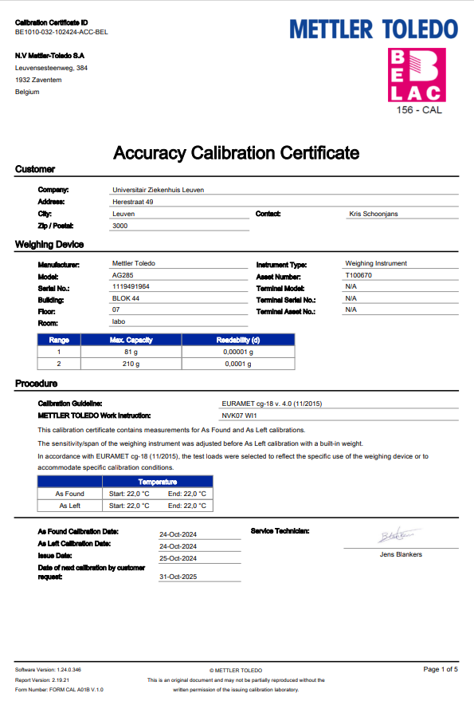
Example of calibration
Used Calibration procedure
Notes:
Geaccrediteerde leverancier hoeft er niet aangetoond te worden dat deze aan de vereisten voldoet
Verdere details ter illustratie van een kalibratieprocedure volgens de voorgenoemde vereisten

Slide 18
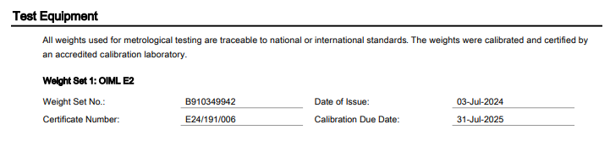
Notes:
Controlegewichten met traceerbaarheid naar nationale of internationale standaarden
OIML
E2 nauwkeurigheidsklasse: gekende meetonzekerheid: bijv. 200 g gewicht heeft eigen meetonzekerheid van 0.30 mg

Slide 19
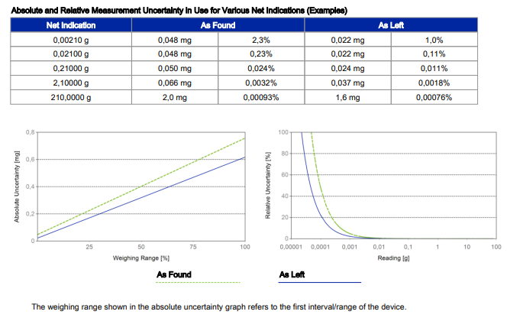
As found and as left evaluation
Tolerance limit specified by the procedure of the laboratory : 0,01%
➔ measurement uncertainty is within specified tolerance limit ➔acceptability criteria passed
Notes:
Kalibratie voor en na justering van de balans: voor beide zou de nauwkeurigheid en meetonzekerheid binnen de acceptatiegrenzen moeten vallen

Slide 20
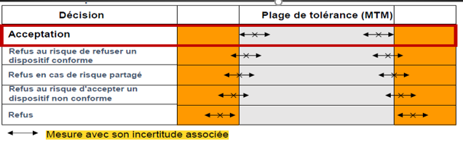
If Calibration/Verification result is outside criteria defined by the lab:
Analysis: root cause, extent + impact (take into account as found and as left)
Document corrections and corrective actions (adjustment, re-calibration, …)
  (Help ? ➔ Guidelines ILAC G24)
G24: “Guidelines for the determination of calibration intervals of measuring instruments” )
Notes:
Même en cas de conformité (par exemple, après un ajustement, vous devez également examiner la situation telle qu'elle a été constatée pour savoir si des mesures sont nécessaires), des mesures peuvent donc s'avérer nécessaires.
ILAC Guidelines: International Lab Accrédition Cooperation

Slide 21
Conclusion
Harmonization of Comments of practical guidelines with ISO15189 + BELAC requirents,
Leading to increased rigor and action for all analyses.
Globally, new precisions on frequency, certified materials, to analyze the impact on patient outcomes (results),specific traceability requirement ( semi-quantitative and qualitative methods)
ILAC guidelines are free and provide valuable assistance (e.g. G24).
To summarize advised steps:
  ➔ Risk assessment (on patient and service provided)
  ➔ Criticality status
  ➔ Calibration/verification + Specified intervals (& Records)
  ➔ Actions (impact analysis, id. root cause) to be taken if is outside criteria defined by the lab (& Records)
Notes:
En conclusion, l’exigence obligatoire des directives de 2017 ne change pas. En revanche, les commentaires/exigences facultative de notre version 2025 rejoignent les précisions retrouvées dans la version 2022 de notre norme ISO15189.
Ces précisions concernent la fréquence de calibration, l’analyse d’impact sur les résultats patients, l’(utilisation de CRM et des précisions à propos des méthodes non-quantitaives

Slide 22
Thank you for your attention

Slide 23
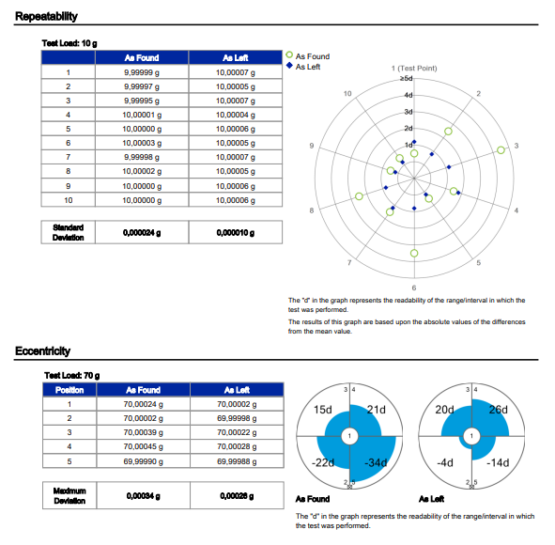
Eccentricity and Repeatability of load is tested during calibration
factors taken into account for the uncertainty

Slide 24
